Slide 1
The stationery shop
Guided by: dr. snehal joshi
Submitted by:
mulle pratik (83) & Pancholi priyank (84)

Slide 2
Project goal
Online stationery shopping is the process whereby consumers directly buy stationery from the seller in real time without an intermediary services, over the internet.
It is a form of electronic commerce.
This project is an attempt to provide the advantage of online stationery shopping to customers of real stationery shop.
It helps buying the product in the stationery shop anywhere through the internet by using your device.
Thus the customer will get the service of online stationery shopping and home delivery from his favorite’s stationery shop.

Slide 3
objectives
Time and energy saving
Availability
Comparison of products and price.
The objective of the project is to make an web application to purchase stationery products in an existing stationery shop.
In order to build such a web application complete web support need to be provided.
A complete and efficient web application which can provide the online stationery shopping experience is the basis objective of the project.
The web application can be implemented in the form of an web application with web view.
Service or product advertising

Slide 4
objectives
To be able to easily save money and compare prices from website to website.
Online resellers tent to sell at a lower price due to less overhead expenses.
It is time saving and energy saving. Person can easily login to online site while sitting at home. So by this we can say that it is time as energy saving.
People while sitting at one place, can reach to number of product with different varieties and can order them and would get them at their door step.
Online stationery shopping gives the benefits of comparing the products on the various attributes like pricing, texture, substitution of product etc…..
Thus, our aim of our project is to have understanding about the online stationery shopping behaviors among different age-shoppers.
Continue…

Slide 5
scope
Implemented to any stationery shop in the locality to multinational branded stationery shops having retail outlet chains.
Recommends a facility to accept the order 24*7 and a home delivery system.
If stationery shops are providing an online portal where the customers can enjoy easy product shopping from anywhere.
The stationery shops won’t be losing any more customers to the trending online stationery shops.
Since the application is available in the smartphone it is easily accessible and always available.

Slide 6


Platform environment
Front end used
Php 5.4.16 version
PHP stands for personal home page.
Php is general purpose scripting language that is especially suited to side web development, in which case php generally runs on a web server.
Back end used
MySQL 5.4.12 version
MySQL is a database system used by many websites on the internet.
MySQL is a world’s most popular open source database.
MySQL can be easily installed in all major operating system like Microsoft, windows, Linux, Unix.
Can be easily installed in all major operating system like Microsoft, windows, Linux, Unix.

Slide 7
System requirement analysis
Admin
Admin has the official powers to control the flow of the data from one part of the system to the other. He has the power to manipulate the access of the users to the data.
Login:
This module will contain the login of Admin to add, update and delete of any products from the list.
Manage product:
This module will be manage the products.
Manage categories:
This module will be used to manage the products.
Manage customers:
This module will be manage the Customers.
View and Manage orders:
This module will be used to manage the Customers.
Continue…

Slide 8
System requirement analysis
View and Manage delivery:
This module will be used to manage the upcoming delivery of products.
View feedback:
This module will be used to check the feedback.
View subscriber of newsletter:
This module will be used to view .
Generate Bill:
This module will be used to generate the bill of from the Admin.
Reports :
This module will be contain all reports like customer report, view order report and pending bill report .
logout:
The module will be logout.
Continue…

Slide 9
System requirement analysis
Customer
Register:
This module will contain the registration of Customer by Admin
Users information have to be compelled to be registered within the system thus on establish every of them unambiguously and do the required group action as simple potential.
Login:
This module will be contain the login of the user.
After registration one will log within the system because the operator of the system either on the behalf of user. when this he has the opposite helpful interfaces accessible for any actions.
View products:
This module will be contain view the gift to the user.
Continue…

Slide 10
System requirement analysis
Add to Wishlist:
This module will add into the Wishlist which is selected by the customer.
Add to Cart:
This module will add item into the cart which is selected by the customer.
Order placed:
This module will be used to the customer to place the order.
Order from the shop by the users is stored in this entity and as the no of items and category of the item. As the racks are also mentioned in that the update of main stock is done automatically.
Generate bill:
This module will be used to save or generate bill for customer.
Change password :
This module will be used to change password after logging in.
Continue…

Slide 11
System requirement analysis
Forgot password:
This module will be used to recover password.
This is quite often that people tend to forget the password they keep for the login. So this could be very tedious and hectic to recover the password manually in case if one needs to log in in the emergency.
So to overcome this problem we have this module named ass forgot the password
So here we need to only put our registered email Id and hit the enter.
than one confirmation email will go to the email where he has the option to reset the password.
View order History:
This module will be used to view the order of the history.
Logout:
This module will contain the customer logout.

Slide 12
System flow diagram (sfd)
output

Slide 13
Data flow diagram
Context or 0 level dfd

Slide 14
Admin : 1st level dfd
view reports
Manage reports

Slide 15
Admin : 2nd level dfd for 3.0

Slide 16
Admin : 2nd level dfd for 4.0

Slide 17
Admin : 2nd level dfd for 5.0

Slide 18
Admin : 2nd level dfd for 6.0

Slide 19
customer : 1st level dfd

Slide 20
customer : 2nd level dfd for 3.0

Slide 21
customer : 2nd level dfd for 4.0

Slide 22
E-r diagram

Slide 23
Data dictionary
1.Admin_login
Field | Type | Constraint | Description
AID | int(5) | Primary key | Admin id
name | varchar(20) |  | Name of admin
email | varchar(50) |  | Email id of admin
password | varchar(20) |  | Password
dob | date |  | Date of birth
image | varchar(50) |  | Image of admin

Slide 24
Data dictionary
2. User_master
Field | Type | Constraint | Description
UID | int(5) | primary key | User id
fname | varchar(20) |  | First name
lname | varchar(20) |  | Last name
mobile | varchar(10) |  | Mobile no
email | varchar(30) |  | Email id
uimage | varchar(50) |  | Image of user

Slide 25
Data dictionary
3. User_login
Field | Type | Constraint | Description
UID | int(5) |  | User id
email | varchar(30) |  | Email id
password | varchar(20) |  | Password
sec_ques | varchar(30) |  | Security question
sec_ans | varchar(30) |  | Security answer
vemail | tinyint(1) |  | Email verification

Slide 26
Data dictionary
4. address
Field | Type | Constraint | Description
ADDID | int(5) | primary key | Address id
UID | int(5) | foreign key | User id
city | varchar(15) |  | City name
state | varchar(15) |  | State name
pincode | varchar(8) |  | Pincode no.
address | varchar(40) |  | Full address
landmark | varchar(20) |  | Landmark

Slide 27
Data dictionary
5. products
Field | Type | Constraint | Description
PID | int(5) | primary key | Product id
pname | varchar(45) |  | Product name
pdesc | varchar(500) |  | Description
brand | varchar(50) |  | Brand of product
pprice | int(5) |  | Product price
pimage | varchar(30) |  | Product image
pdiscount | varchar(2) |  | Discount
ptag | varchar(50) |  | Product tags
date | date |  | Date of inserted
CID | int(5) | foreign key | Categories id

Slide 28
Data dictionary
6. Cart_master
Field | Type | Constraint | Description
CTID | int(5) | primary key | Cart id
UID | int(5) | Foreign key | User id
total_cost | int(5) |  | Total amount to be pay
7. Cart_details
Field | Type | Constraint | Description
CTID | int(5) | foreign key | Cart id
PID | int(5) | foreign key | Products id
quantity | int(5) |  | Quantity

Slide 29
Data dictionary
8. orders
Field | Type | Constraint | Description
OID | int(5) | primary key | Order id
UID | int(5) | foreign key | User id
PID | int(5) | foreign key | Product id
ADDID | int(5) | foreign key | Address id
quantity | int(5) |  | Quatity
price | int(5) |  | Price of product
order_date | datetime |  | Order date
pay_method | varchar(20) |  | Payment method
status | varchar(10) |  | Status of orders

Slide 30
Data dictionary
9. delivery
Field | Type | Constraint | Description
OID | int(5) | foreign key | Order id
UID | int(5) | foreign key | User id
PID | int(5) | foreign key | Product id
ADDID | int(5) | foreign key | Address id
quantity | varchar(3) |  | Quantity
price | int(5) |  | Price
date | varchar(10) |  | Date
pay_method | varchar(20) |  | Payment method

Slide 31
Data dictionary
10. wishlist
Field | Type | Constraint | Description
WID | int(5) | primary key | Wishlist id
UID | int(5) | foreign key | User id
PID | int(5) | foreign key | Product id
11. Categories
Field | Type | Constraint | Description
CID | int(5) | Primary key | Categories id
cname | varchar(30) |  | Categories name
scname | varchar(100) |  | Sub categories name

Slide 32
Data dictionary
12. Review
Field | Type | Constraint | Description
ID | int(5) | primary key | Review id
name | varchar(20) |  | Customer name
email | varchar(30) |  | Customer email
review | varchar(50) |  | Review
rating | varchar(5) |  | Ratings
date | date |  | Date of review
PID | int(5) | foreign key | Product id

Slide 33
Data dictionary
13. Contect_us
Field | Type | Constraint | Description
ID | int(5) | primary key | Id
fname | varchar(10) |  | First name
lname | varchar(10) |  | Last name
email | varchar(50) |  | Email id
subject | varchar(20) |  | Subject
message | varchar(50) |  | Message

Slide 34
Data dictionary
14. Brands
Field | Type | Constraint | Description
ID | int(3) | primary key | Id
Name | varchar(30) |  | Name of brand
image | varchar(50) |  | Image of brand
15. Newsletter
Field | Type | Constraint | Description
ID | int(5) | Primary key | Id
email | varchar(50) |  | Email id

Slide 35
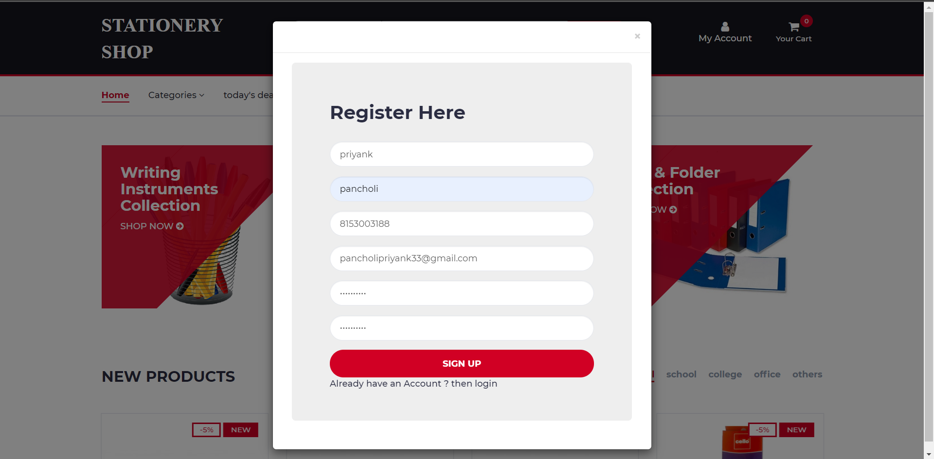
forms : customer register

Slide 36
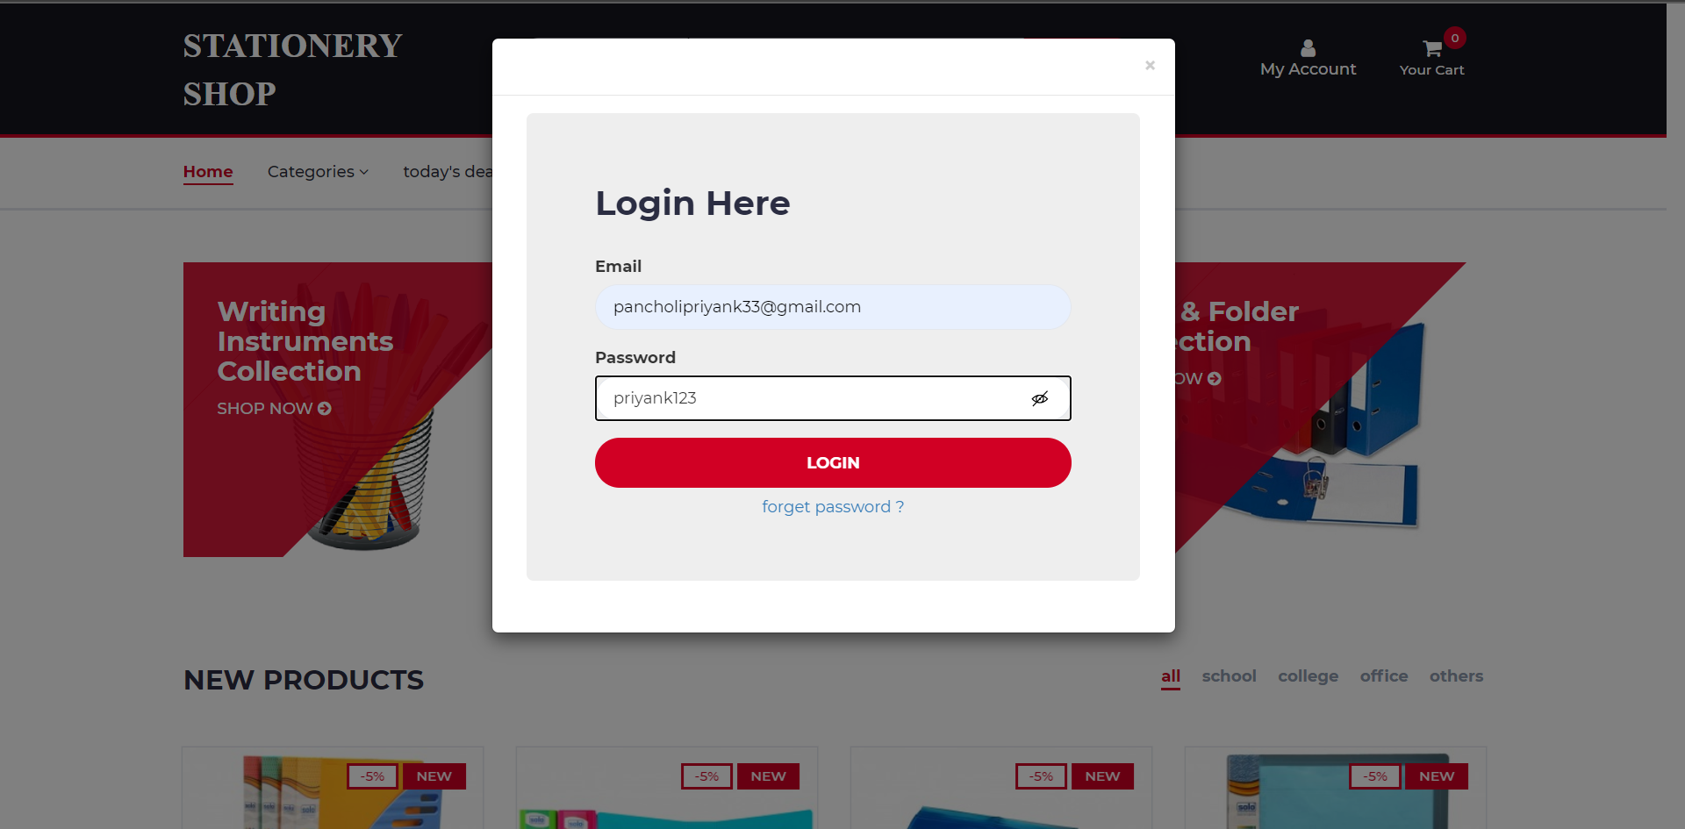
Forms : customer login

Slide 37
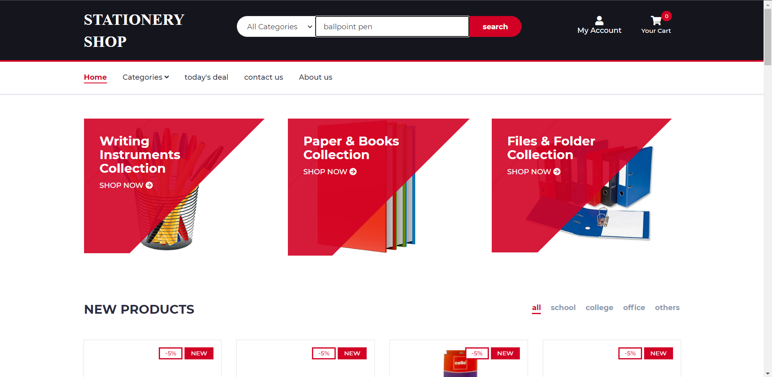
Forms : customer home

Slide 38
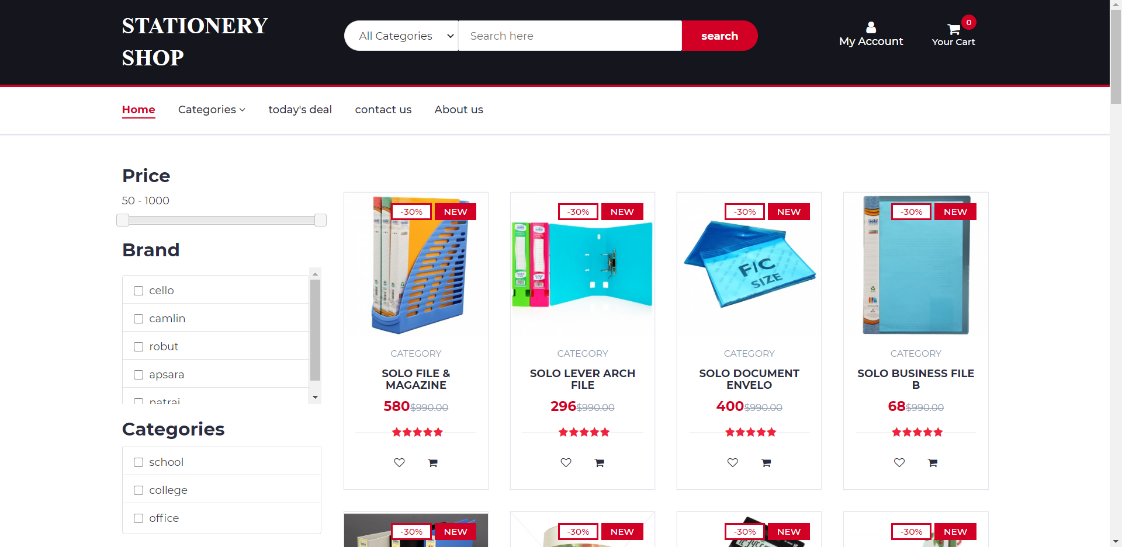
Forms : searched products

Slide 39
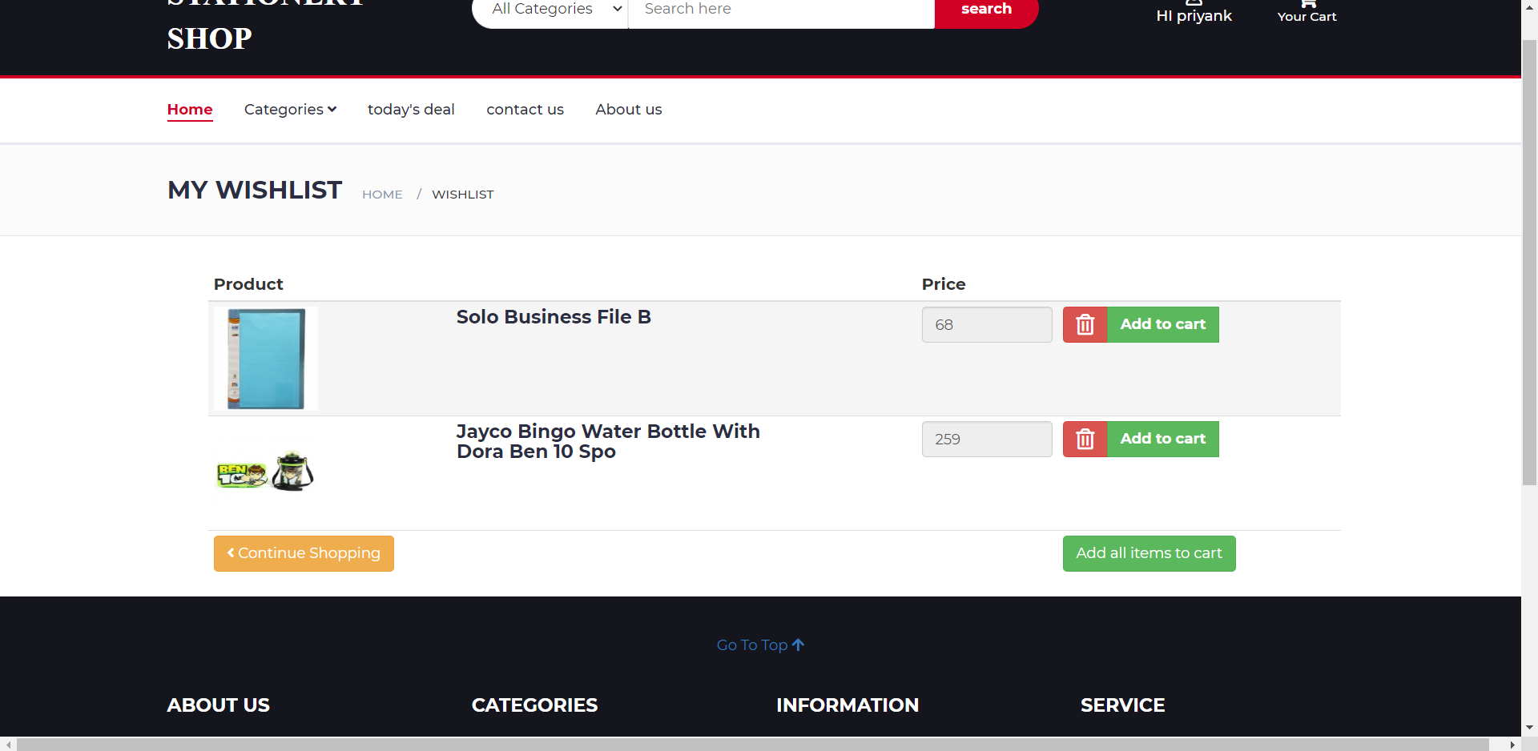
Forms : Wishlist

Slide 40
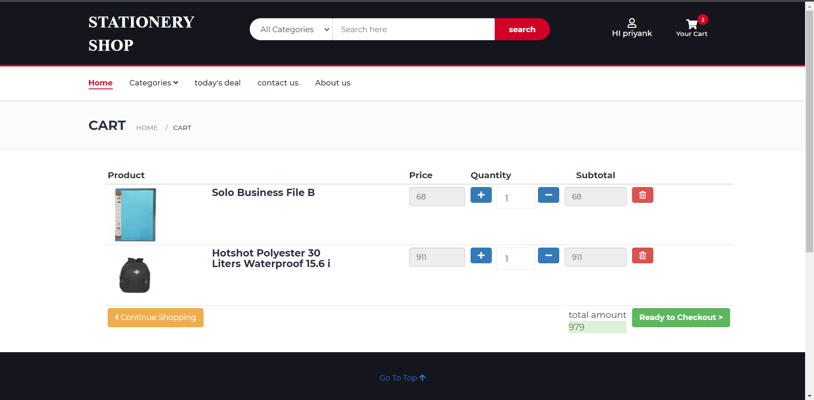
Forms : cart

Slide 41
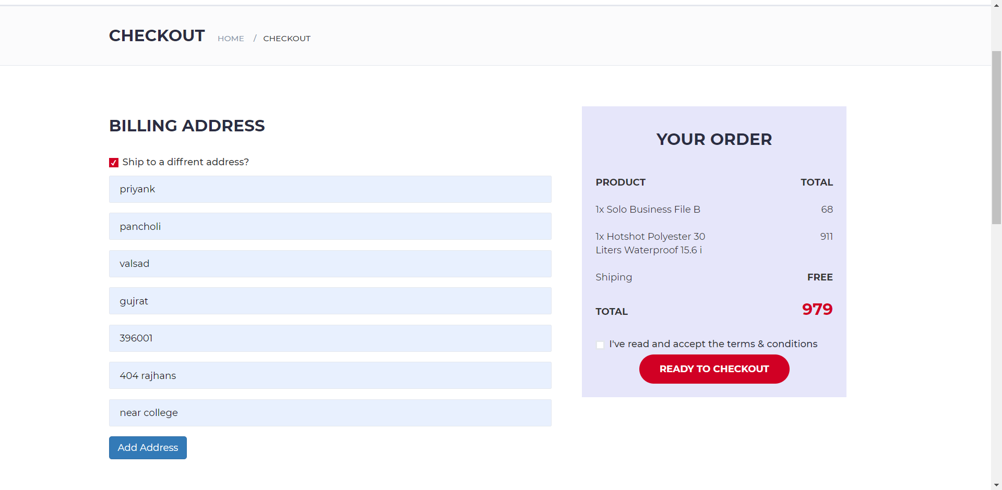
Forms : checkout new address

Slide 42
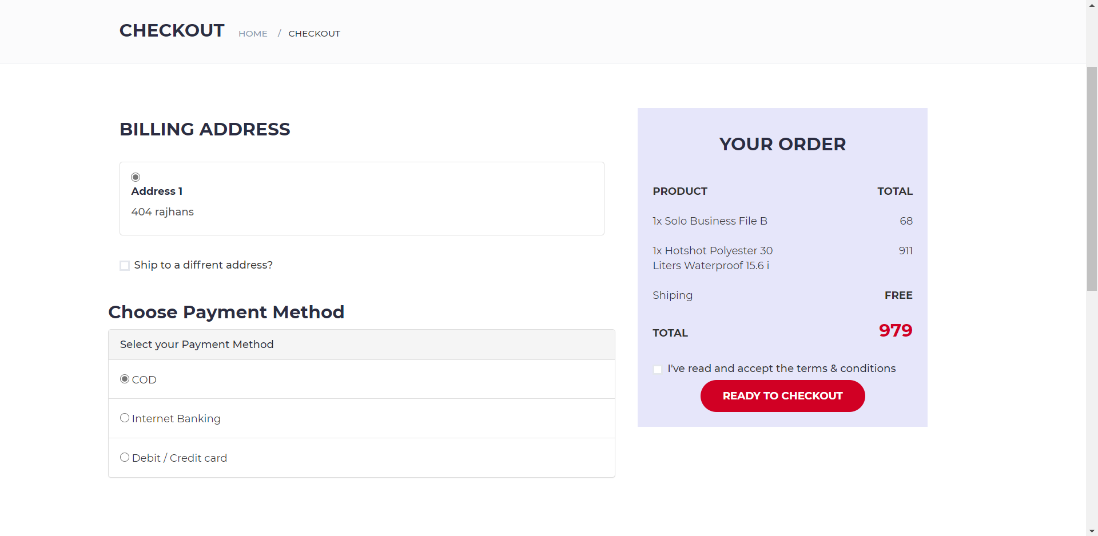
Forms : checkout

Slide 43
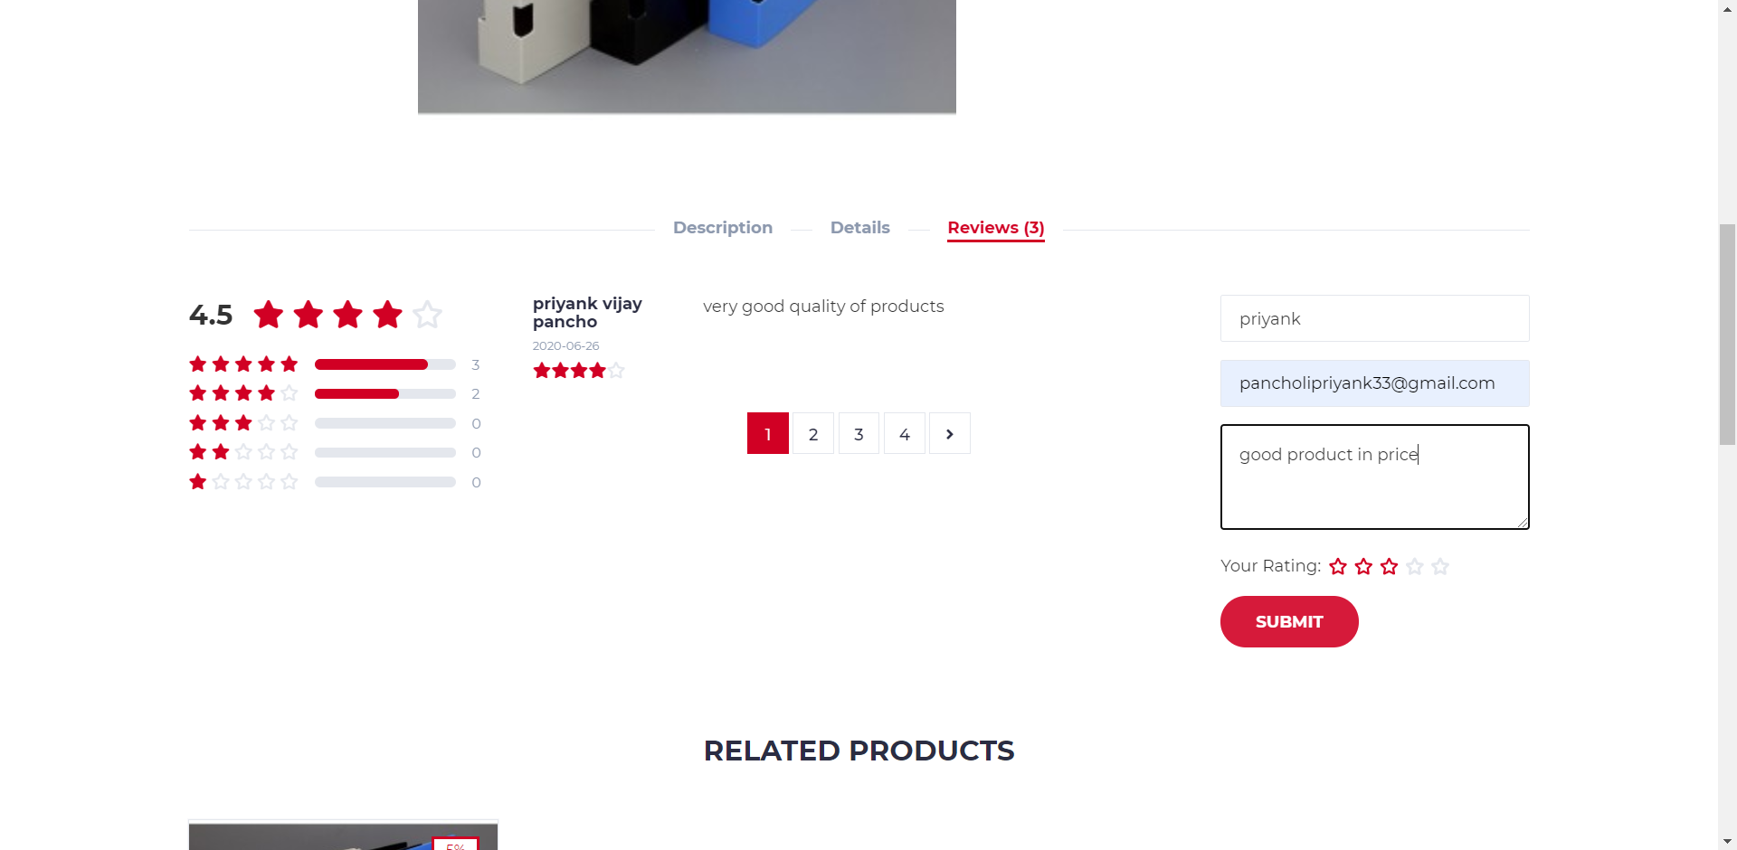
Forms : review

Slide 44
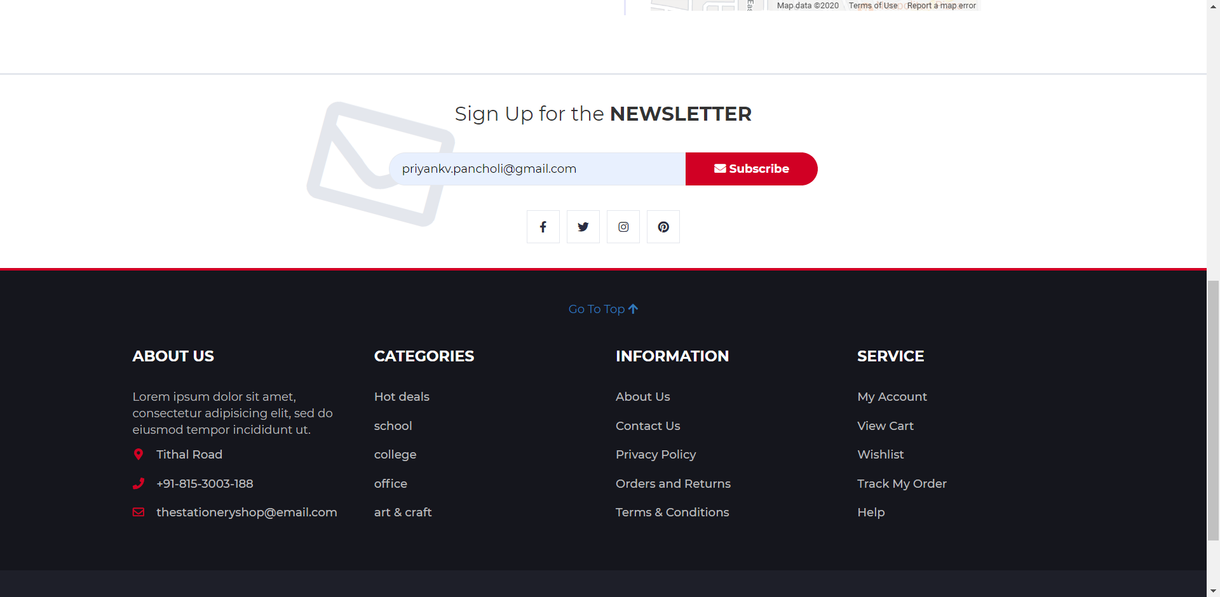
Forms : newsletter

Slide 45
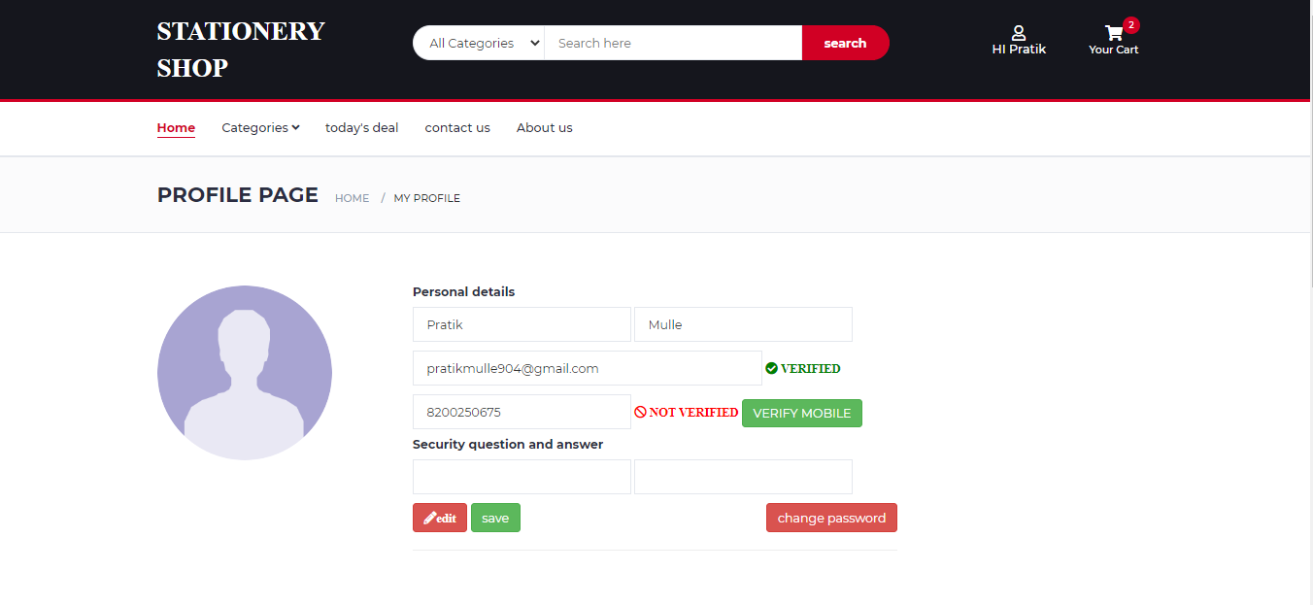
Forms : update profile

Slide 46
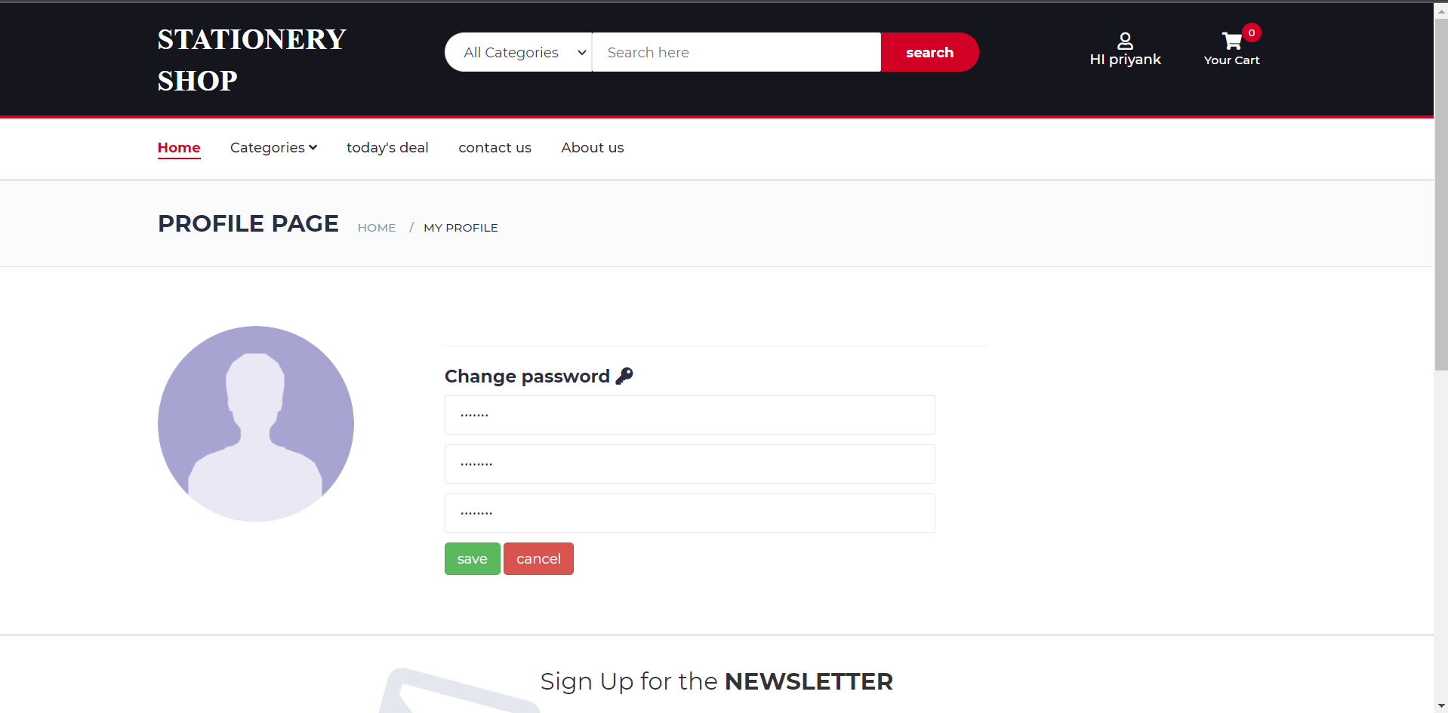
Forms : change password

Slide 47
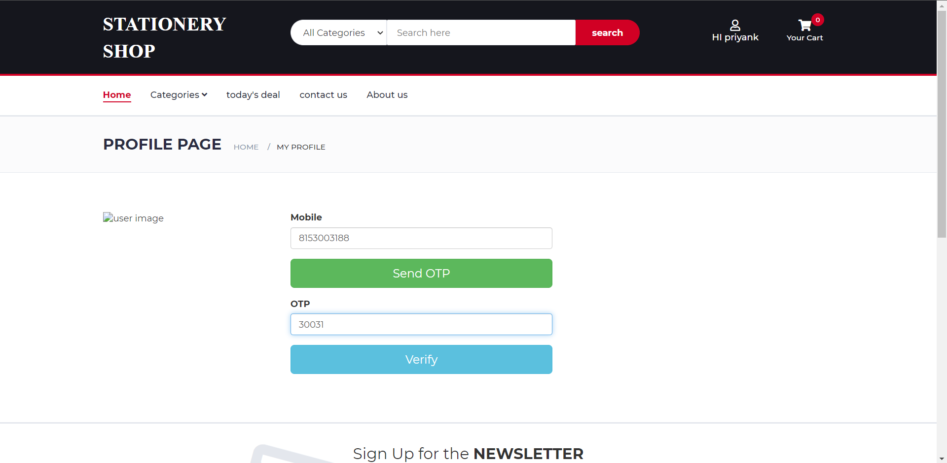
Forms : verify mobile no.

Slide 48
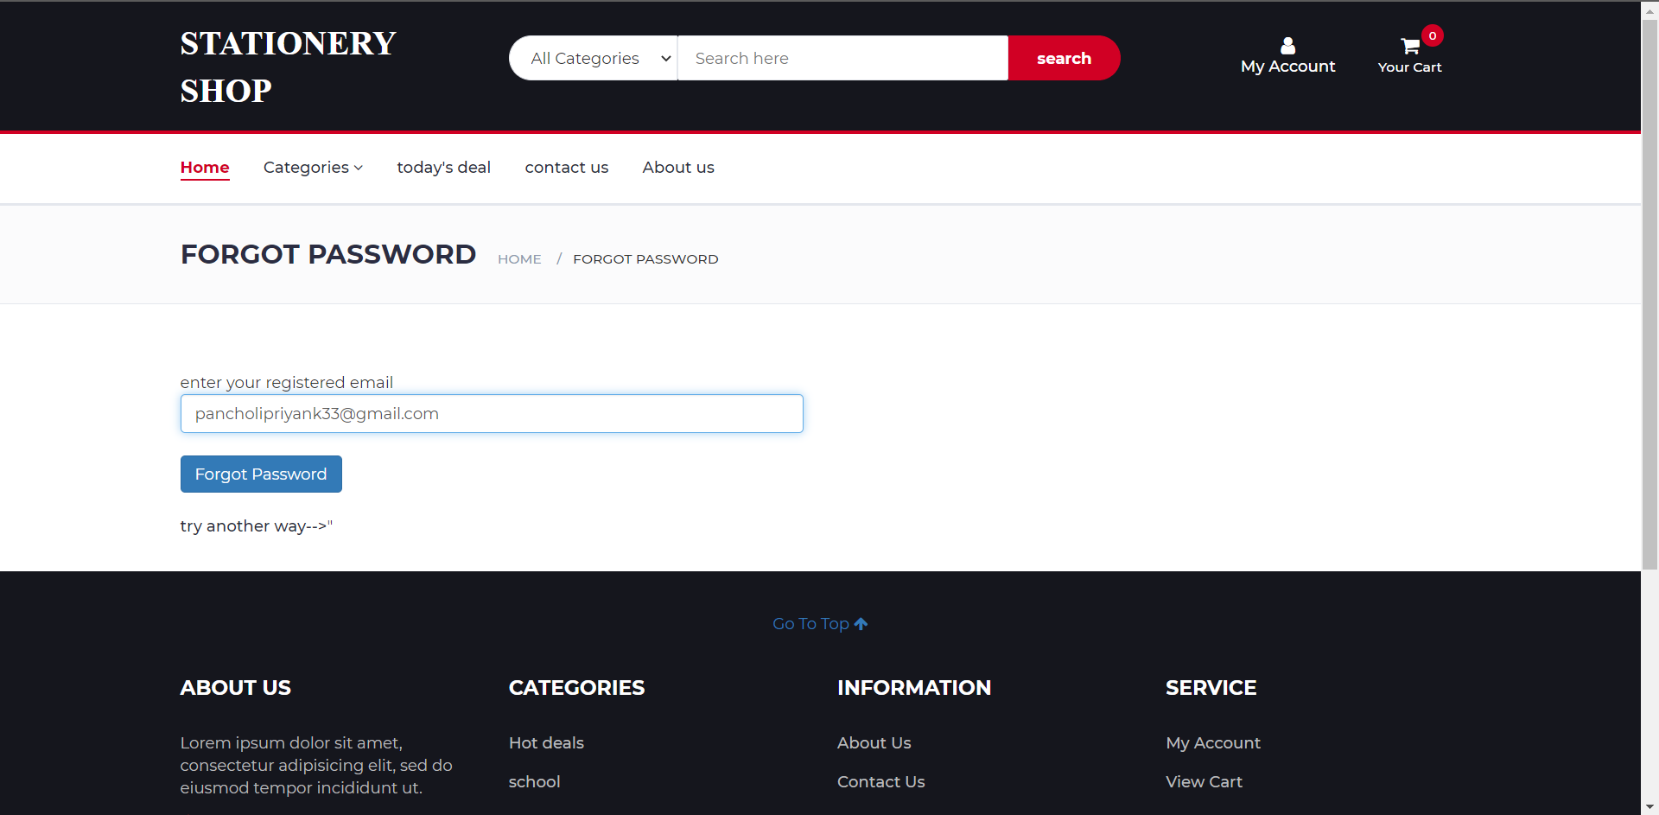
Forms : forgot password

Slide 49
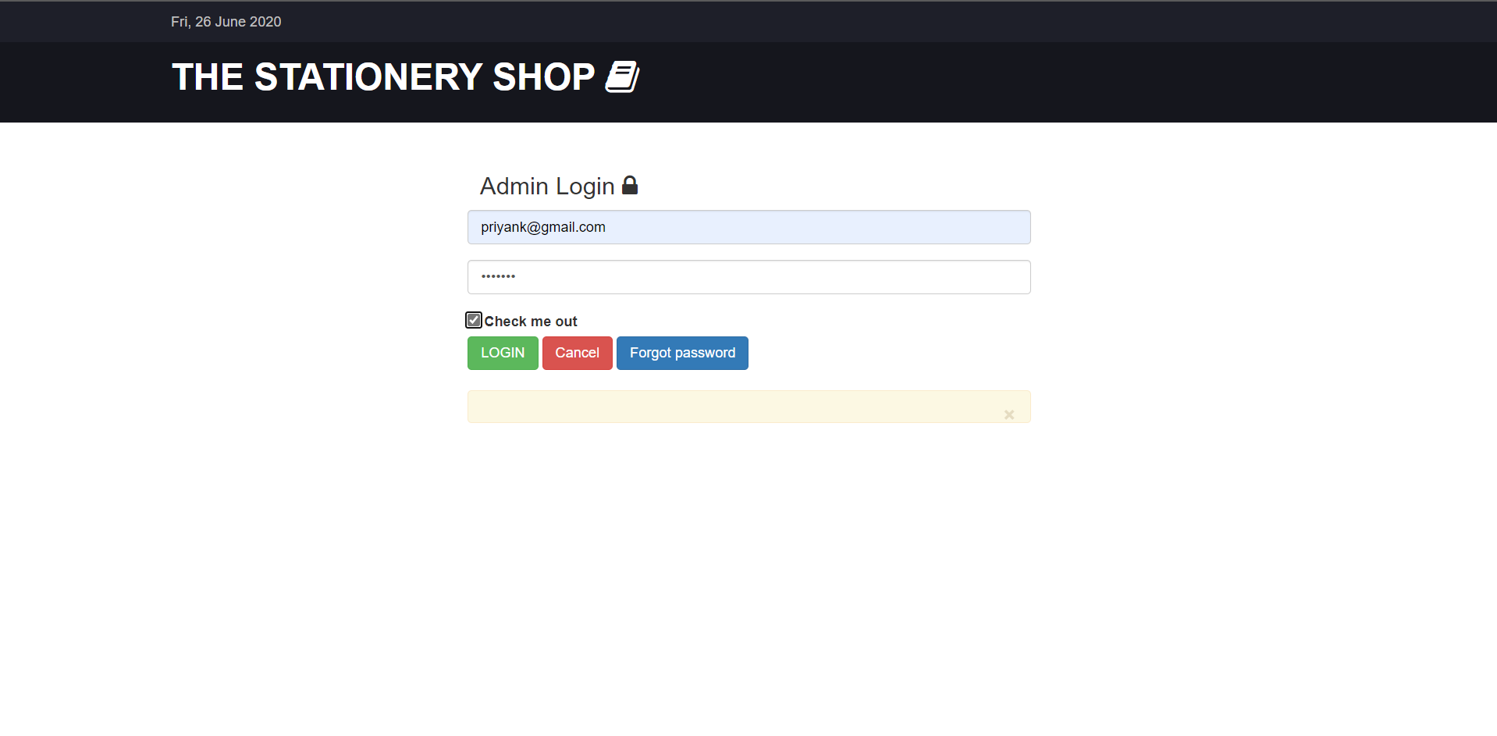
Forms : admin login

Slide 50
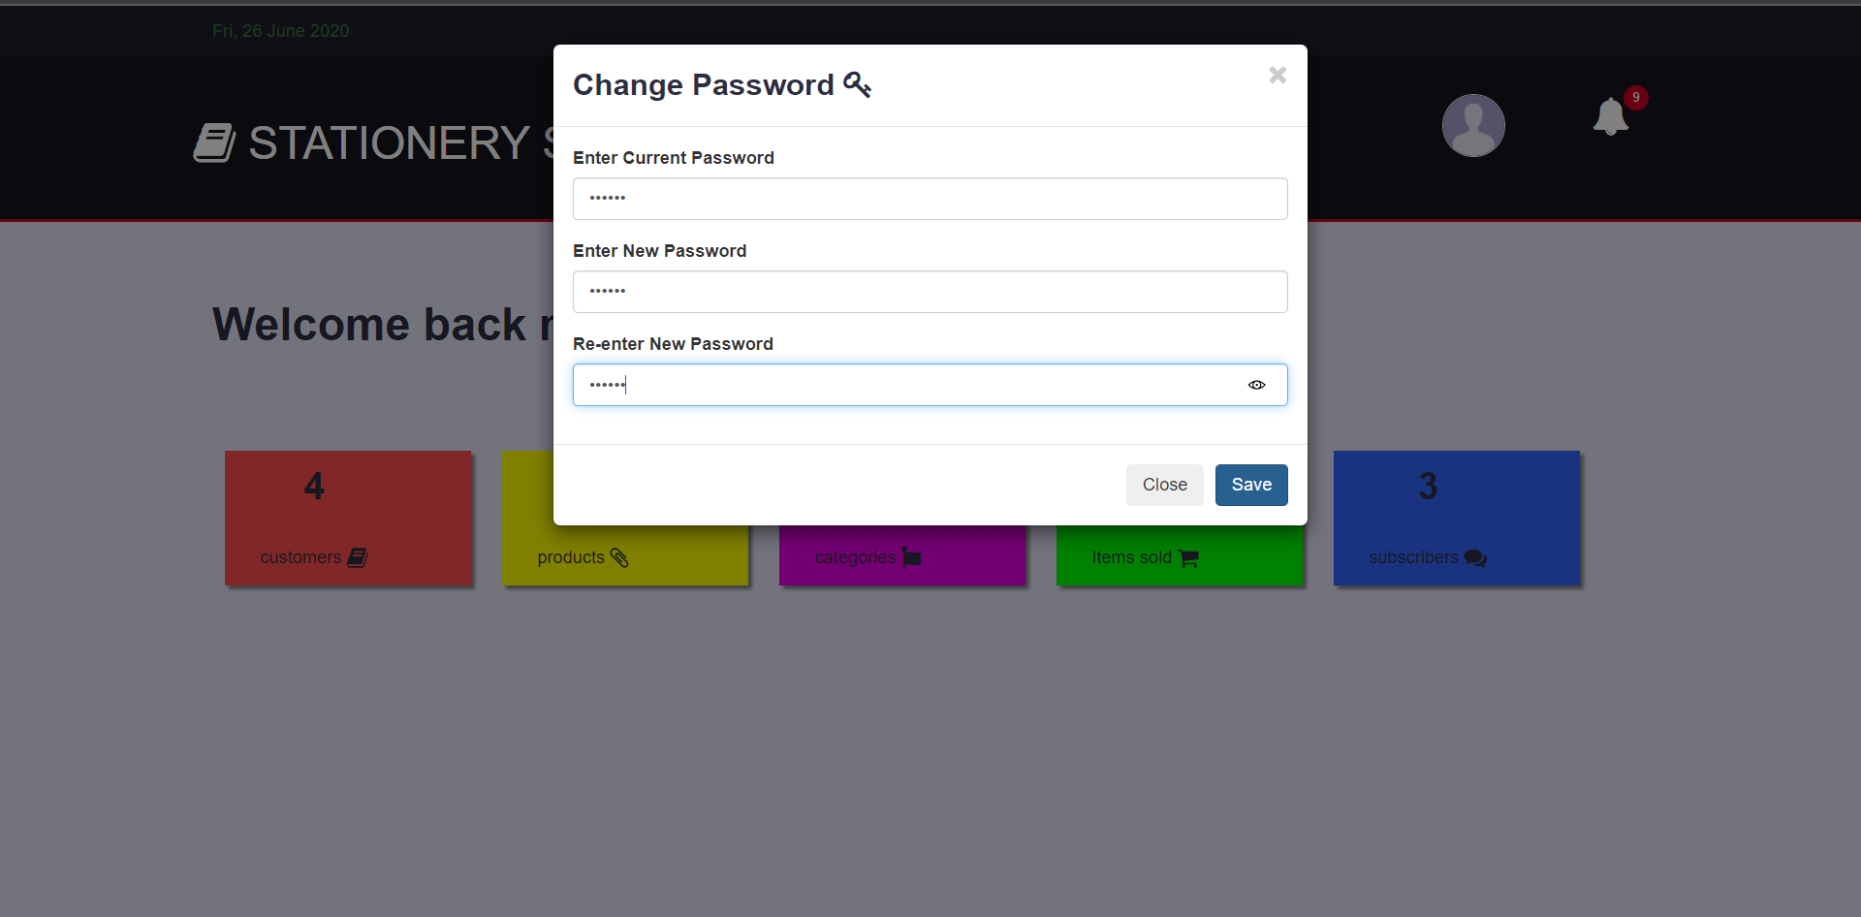
Forms : admin change password

Slide 51
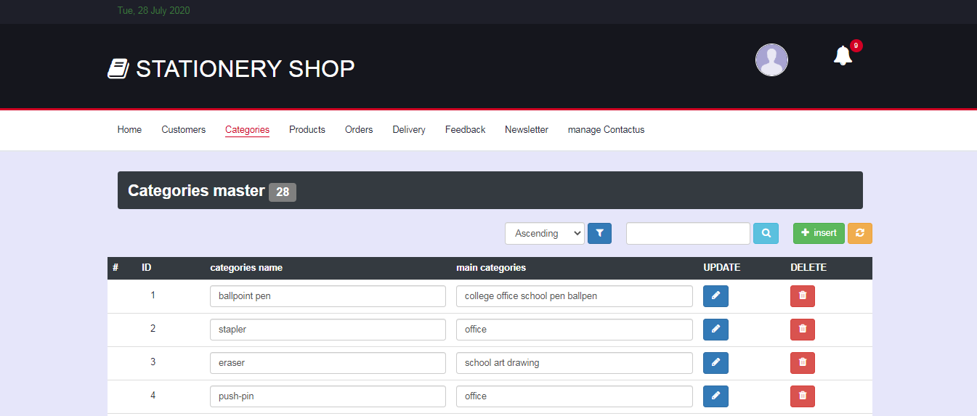
Forms : manage categories

Slide 52
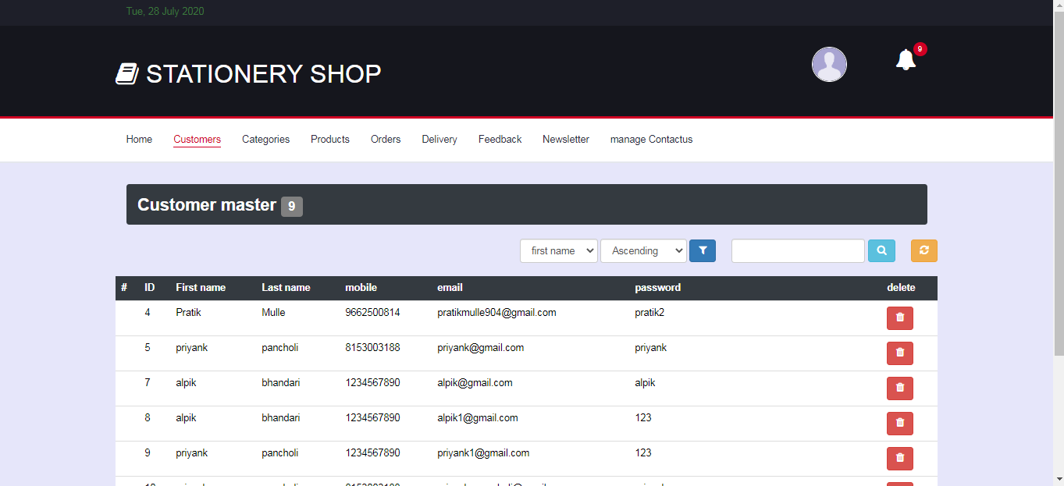
Forms : manage customers

Slide 53
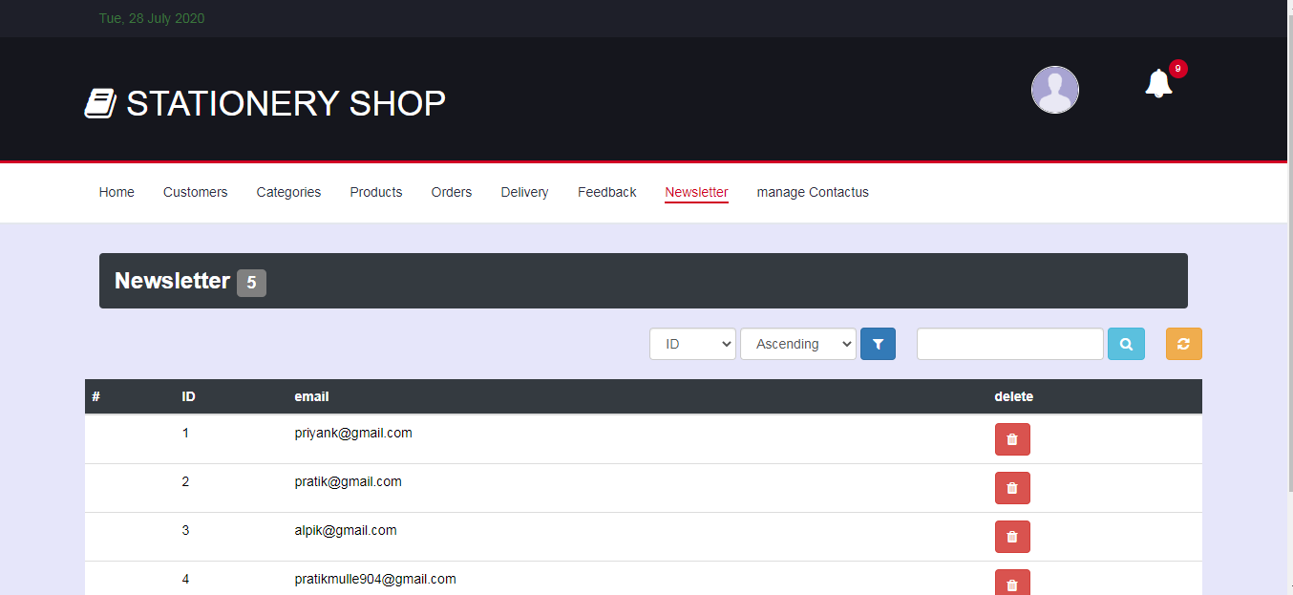
Forms : manage newsletter

Slide 54
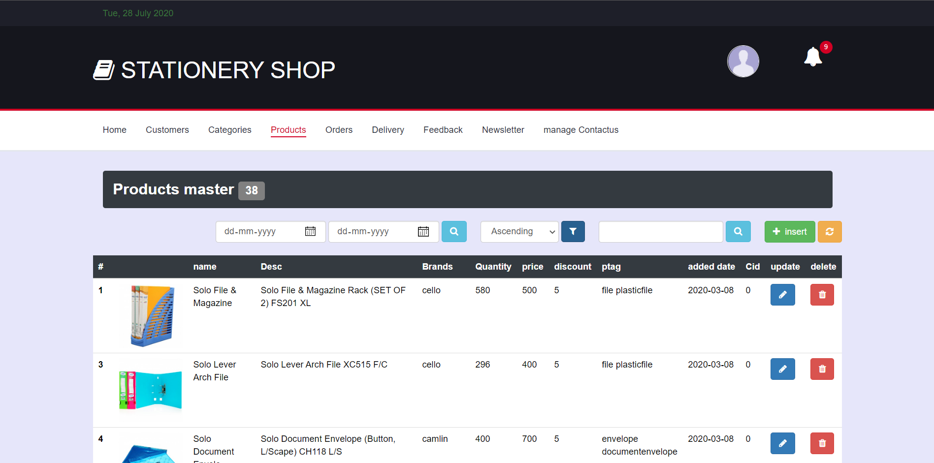
Forms : manage products

Slide 55
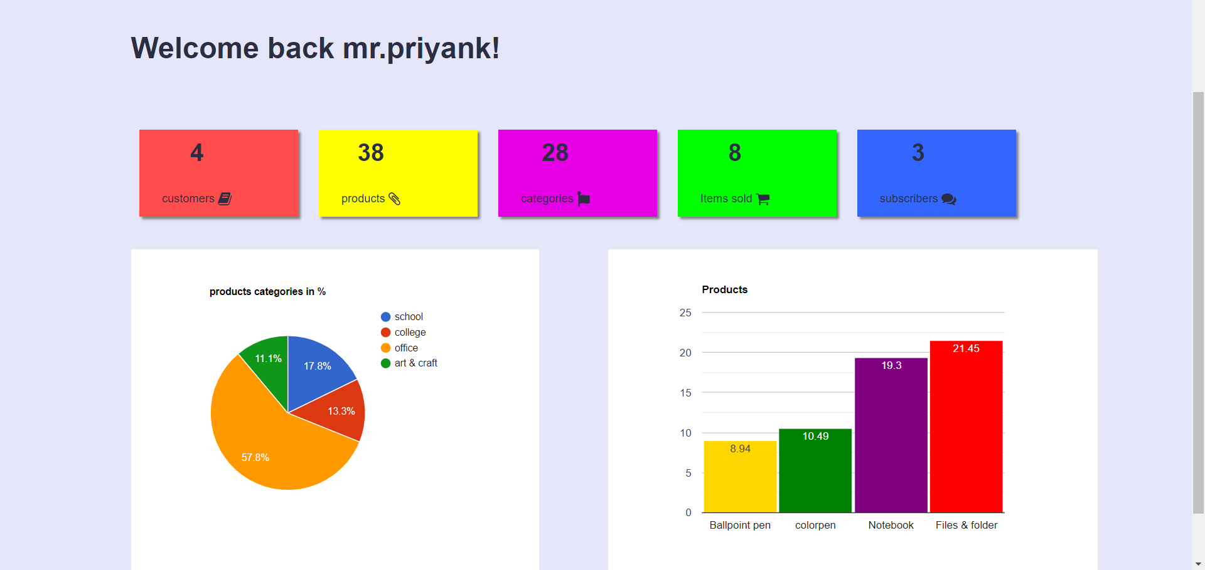
reports : admin reports

Slide 56
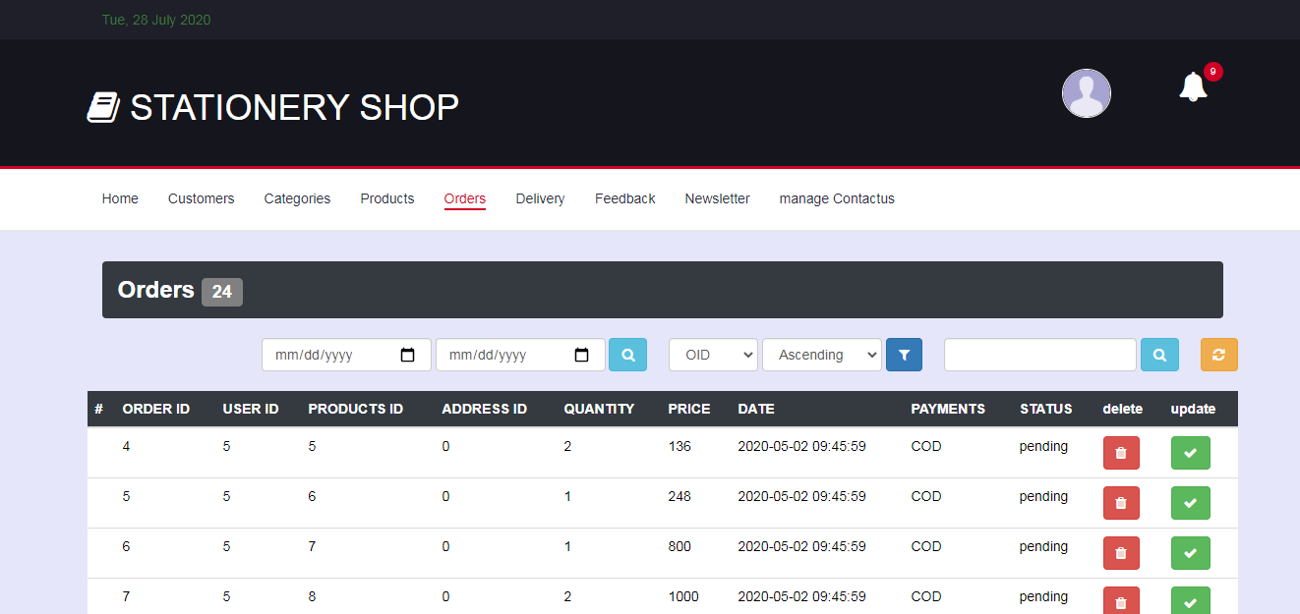
reports : manage orders

Slide 57
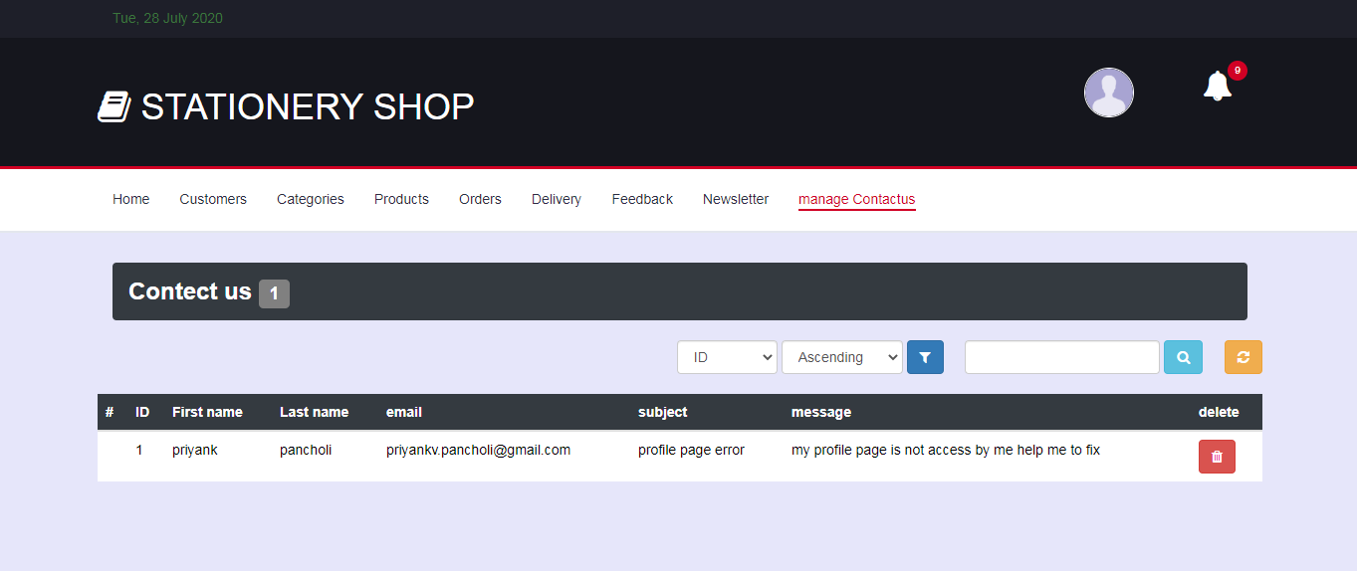
reports : manage contact us

Slide 58
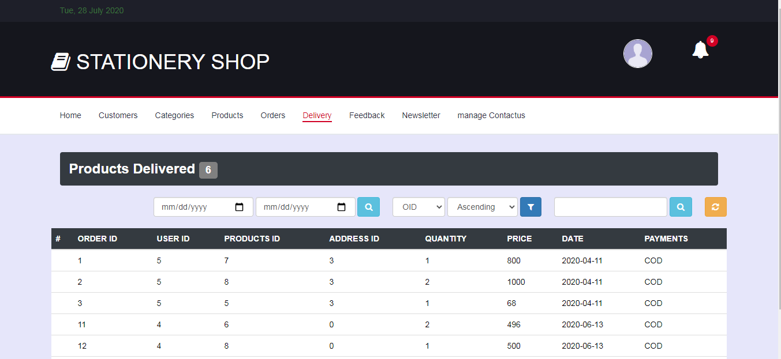
reports : manage delivery

Slide 59
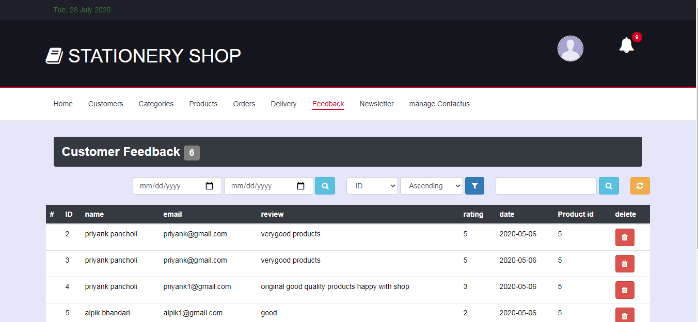
reports : manage feedback

Slide 60
conclusion
We think that not a single project is ever considered as complete forever because our mind is always thinking new and our necessities also are growing.
With the rapid growth of products and brands, people have speculated that online shopping will overtake in-store shopping.
As system is flexible you can generate more reports and screen as and when required.
However, the availability of online shopping has produced a more educated consumer that can shop around with relative ease without having to spend a large amount of time.
In exchange, online stationery shopping has opened up doors to many small retailers that would never be in business if they had to incur the high cost of owning a brick and mortar store. At the end, it has been a win-win situation for both consumer and sellers.

Slide 61
Future enhancement
Providing products comparison.
Providing whole sale products to sellers.
In future, we can further enhance this software for tablets and mobile phones.
Later basis software is developed as friendly and attractive
Add more security features

Slide 62
references
books
Essence of php
website
www.colorlib.com
www.tutorialspoint.com
www.w3school.com

Slide 63
Thank you

